Slide 1

TITLE: IMAGE SUPER-RESOLUTION USING A IMPROVED GENERATIVE ADVERSARIAL NETWORK
DEPARTMENT OF INFORMATION TECHNOLOGY AND COMPUTER APPLICATIONS
GUIDE NAME: DR.S.NYMATHULLA
K.CHAITANYA(211FA07097)
B.NITIN(211FA07139)

Slide 2
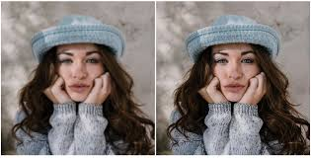
What is Super Resolution?
Restore High-Resolution image or video from Low-ResoIution image or video
According to the number of input LR images, SR can be classified SISR or MISR
Single Image Super Resolution(SISR) , Multi Image Super Resolution (MISR)

Slide 3
STEPS:-
Generator:- upscales low-resolution images and adds high-frequency details.
Discriminator:- ensures the generated image is realistic and high-quality.
Perceptual Loss:- helps focus on realistic textures and high-level features.
Residual Learning:- refines the image by learning and adding missing details.
Skip Connections:- preserve original content while adding fine details.
GAN-Based Training:- improves texture restoration and visual quality.
Photo-Realism:- generates high-resolution images with lifelike details.
Artifact Reduction:- minimizes common issues like noise or oversharpening.
Sharper, Clearer Images:- by enhancing fine details and structures.

Slide 4



What is Super resolution?
Single Image Super Resolution
Restore High resoIution image or video from Low-Resolution image or vide

Slide 5



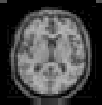



Applications of Super Resolution
Satellite image processing
Medical image processing
Multimedia Industry and Video Enhancement

Slide 6
Workflow of the method:
Input: The low-resolution image is passed to the generator.
Generation: The generator upsamples the image to a high-resolution version.
Discrimination: The discriminator evaluates whether the generated image is real or fake.
Feedback: The discriminator’s feedback is used to update both the generator (to improve its realism) and the discriminator (to become more accurate in distinguishing real vs. fake images).
Loss minimization: The generator minimizes the combination of adversarial, perceptual, and pixel-wise losses to improve the overall quality of the generated images.

Slide 7
Active Plan:-
1. Define the Problem and Dataset Preparation
2. Select the GAN Architecture
3. Adversarial Training
4. Fine-Tuning

Slide 8
Neural network architectures and approaches have evolved significantly in recent years because to advancements in super-resolution techniques. They are :-
PSNR:-Peak Signal-to-Noise Ratio (PSNR) is defined as the ratio between the power of the signal and the power of the noise in an image, indicating the quality of the image with higher values representing better quality by reducing noise.
Bicubic:- Bicubic Interpolation is an interpolation technique used to upscale or downscale images by calculating pixel values based on the surrounding pixels
SRCNN:-Super-Resolution Convolutional Neural Network is a deep convolutional neural network that learns end-to-end mapping of low resolution to high resolution images. As a result, we can use it to improve the image quality of low resolution images.

Slide 9
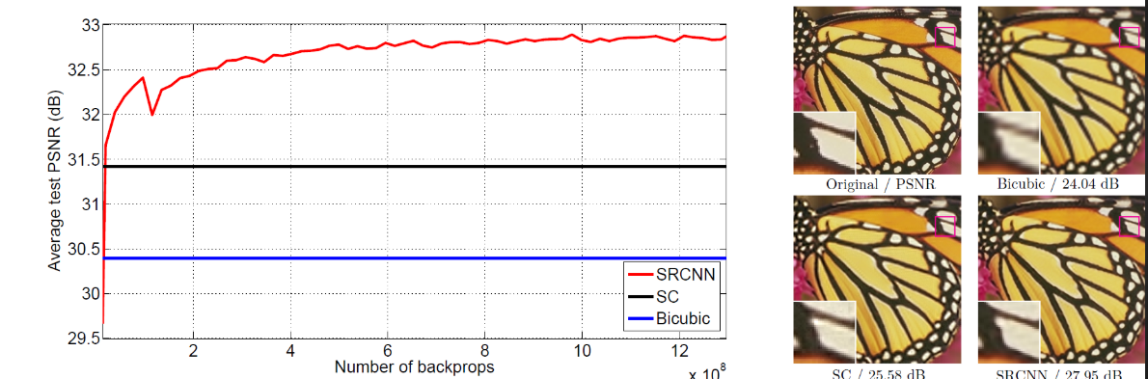
The graph of image clarity to PSNR , Bicubic , SRCN

Slide 10


IMAGE SUPER RESOLUTION USING GAN
BEFORE
AFTER

Slide 11
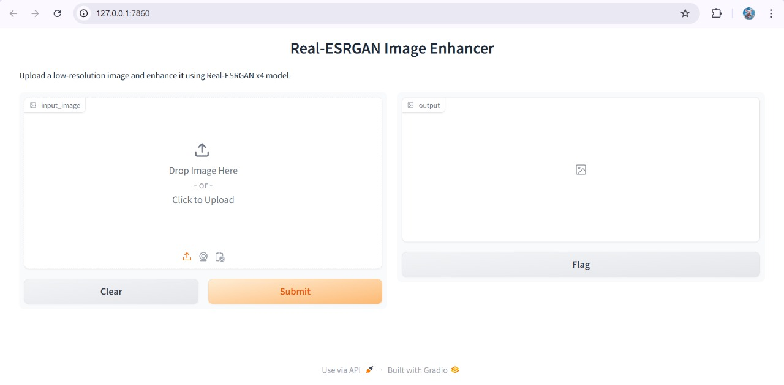

Slide 12
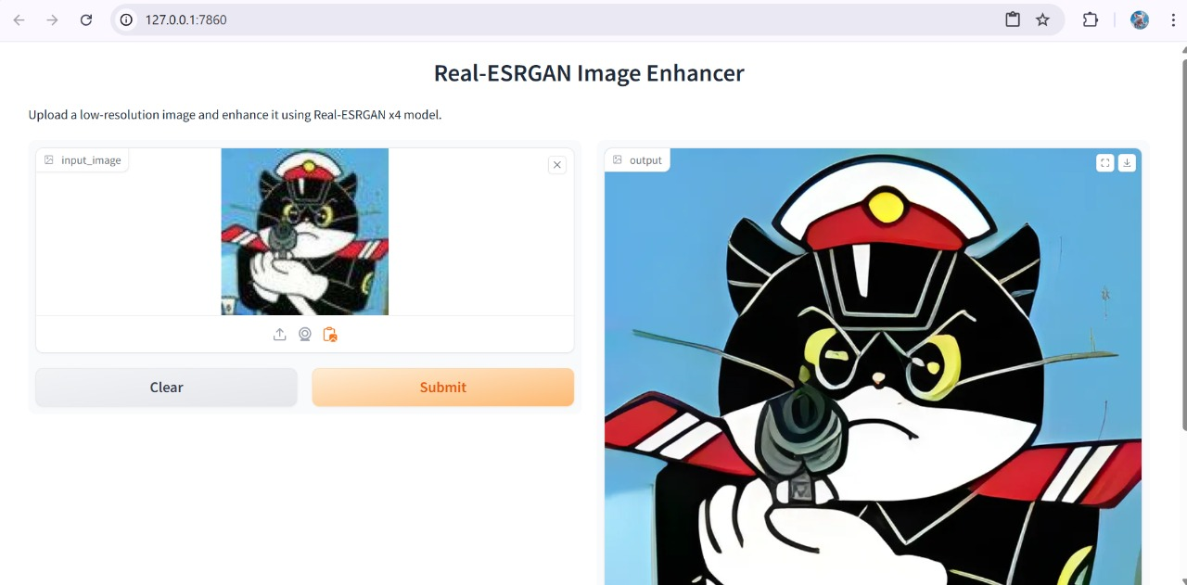

Slide 13
CONCLUSION:-
Single Image Super-Resolution (SISR) aims to enhance the resolution of low-resolution images, reconstructing high-quality, fine-detailed images from their low-resolution counterparts. This challenge has seen remarkable progress in recent years, particularly through the use of deep learning techniques like Generative Adversarial Networks (GANs). GANs have become a dominant approach for SISR because of their ability to generate high-quality, photo-realistic images, especially in scenarios requiring significant upscaling (such as 4× or higher).

Slide 14

This Photo by Unknown Author is licensed under CC BY-SA

